Slide 1
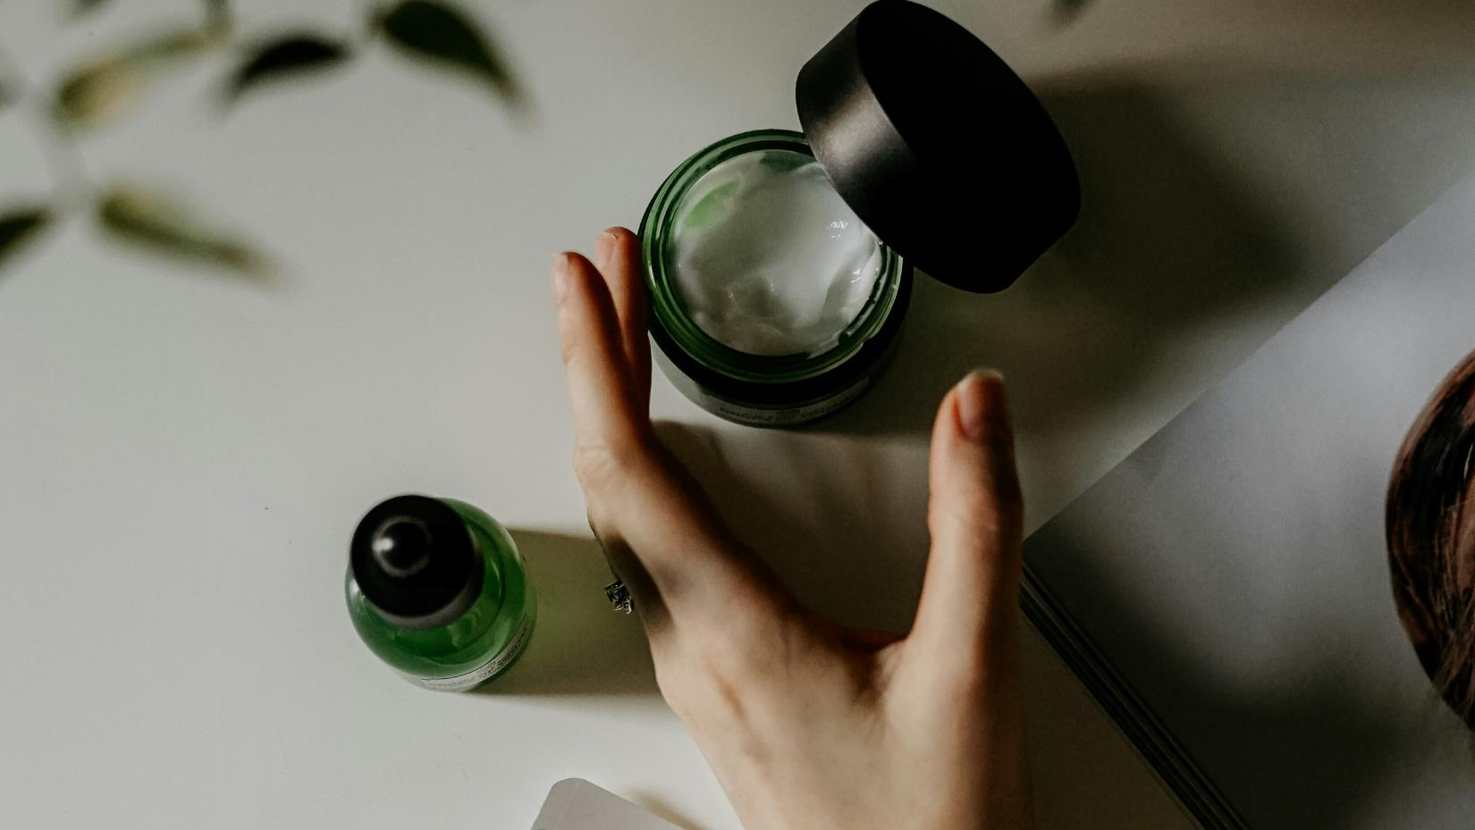
Personalized Skincare Recommendation System
Vinu Basnayake
WIJ22523510

Slide 2

Problem to be Addressed, Importance, and Target Audience
Consumers struggle to find skincare products suited to their unique skin types.
Helps consumers avoid ineffective or harmful products.
Reduces time and expense wasted in product selection.
Individuals with specific skincare needs looking for the most optimal and quality products.

Slide 3

Project Aims and Objectives
Develop a personalized skincare recommendation system that suggests the best products for individual skin types and conditions to use in their skincare routines.
Objectives :
User-friendly web interface for users to complete a skincare questionnaire.
Use an algorithm to analyze responses and select appropriate products.

Slide 4
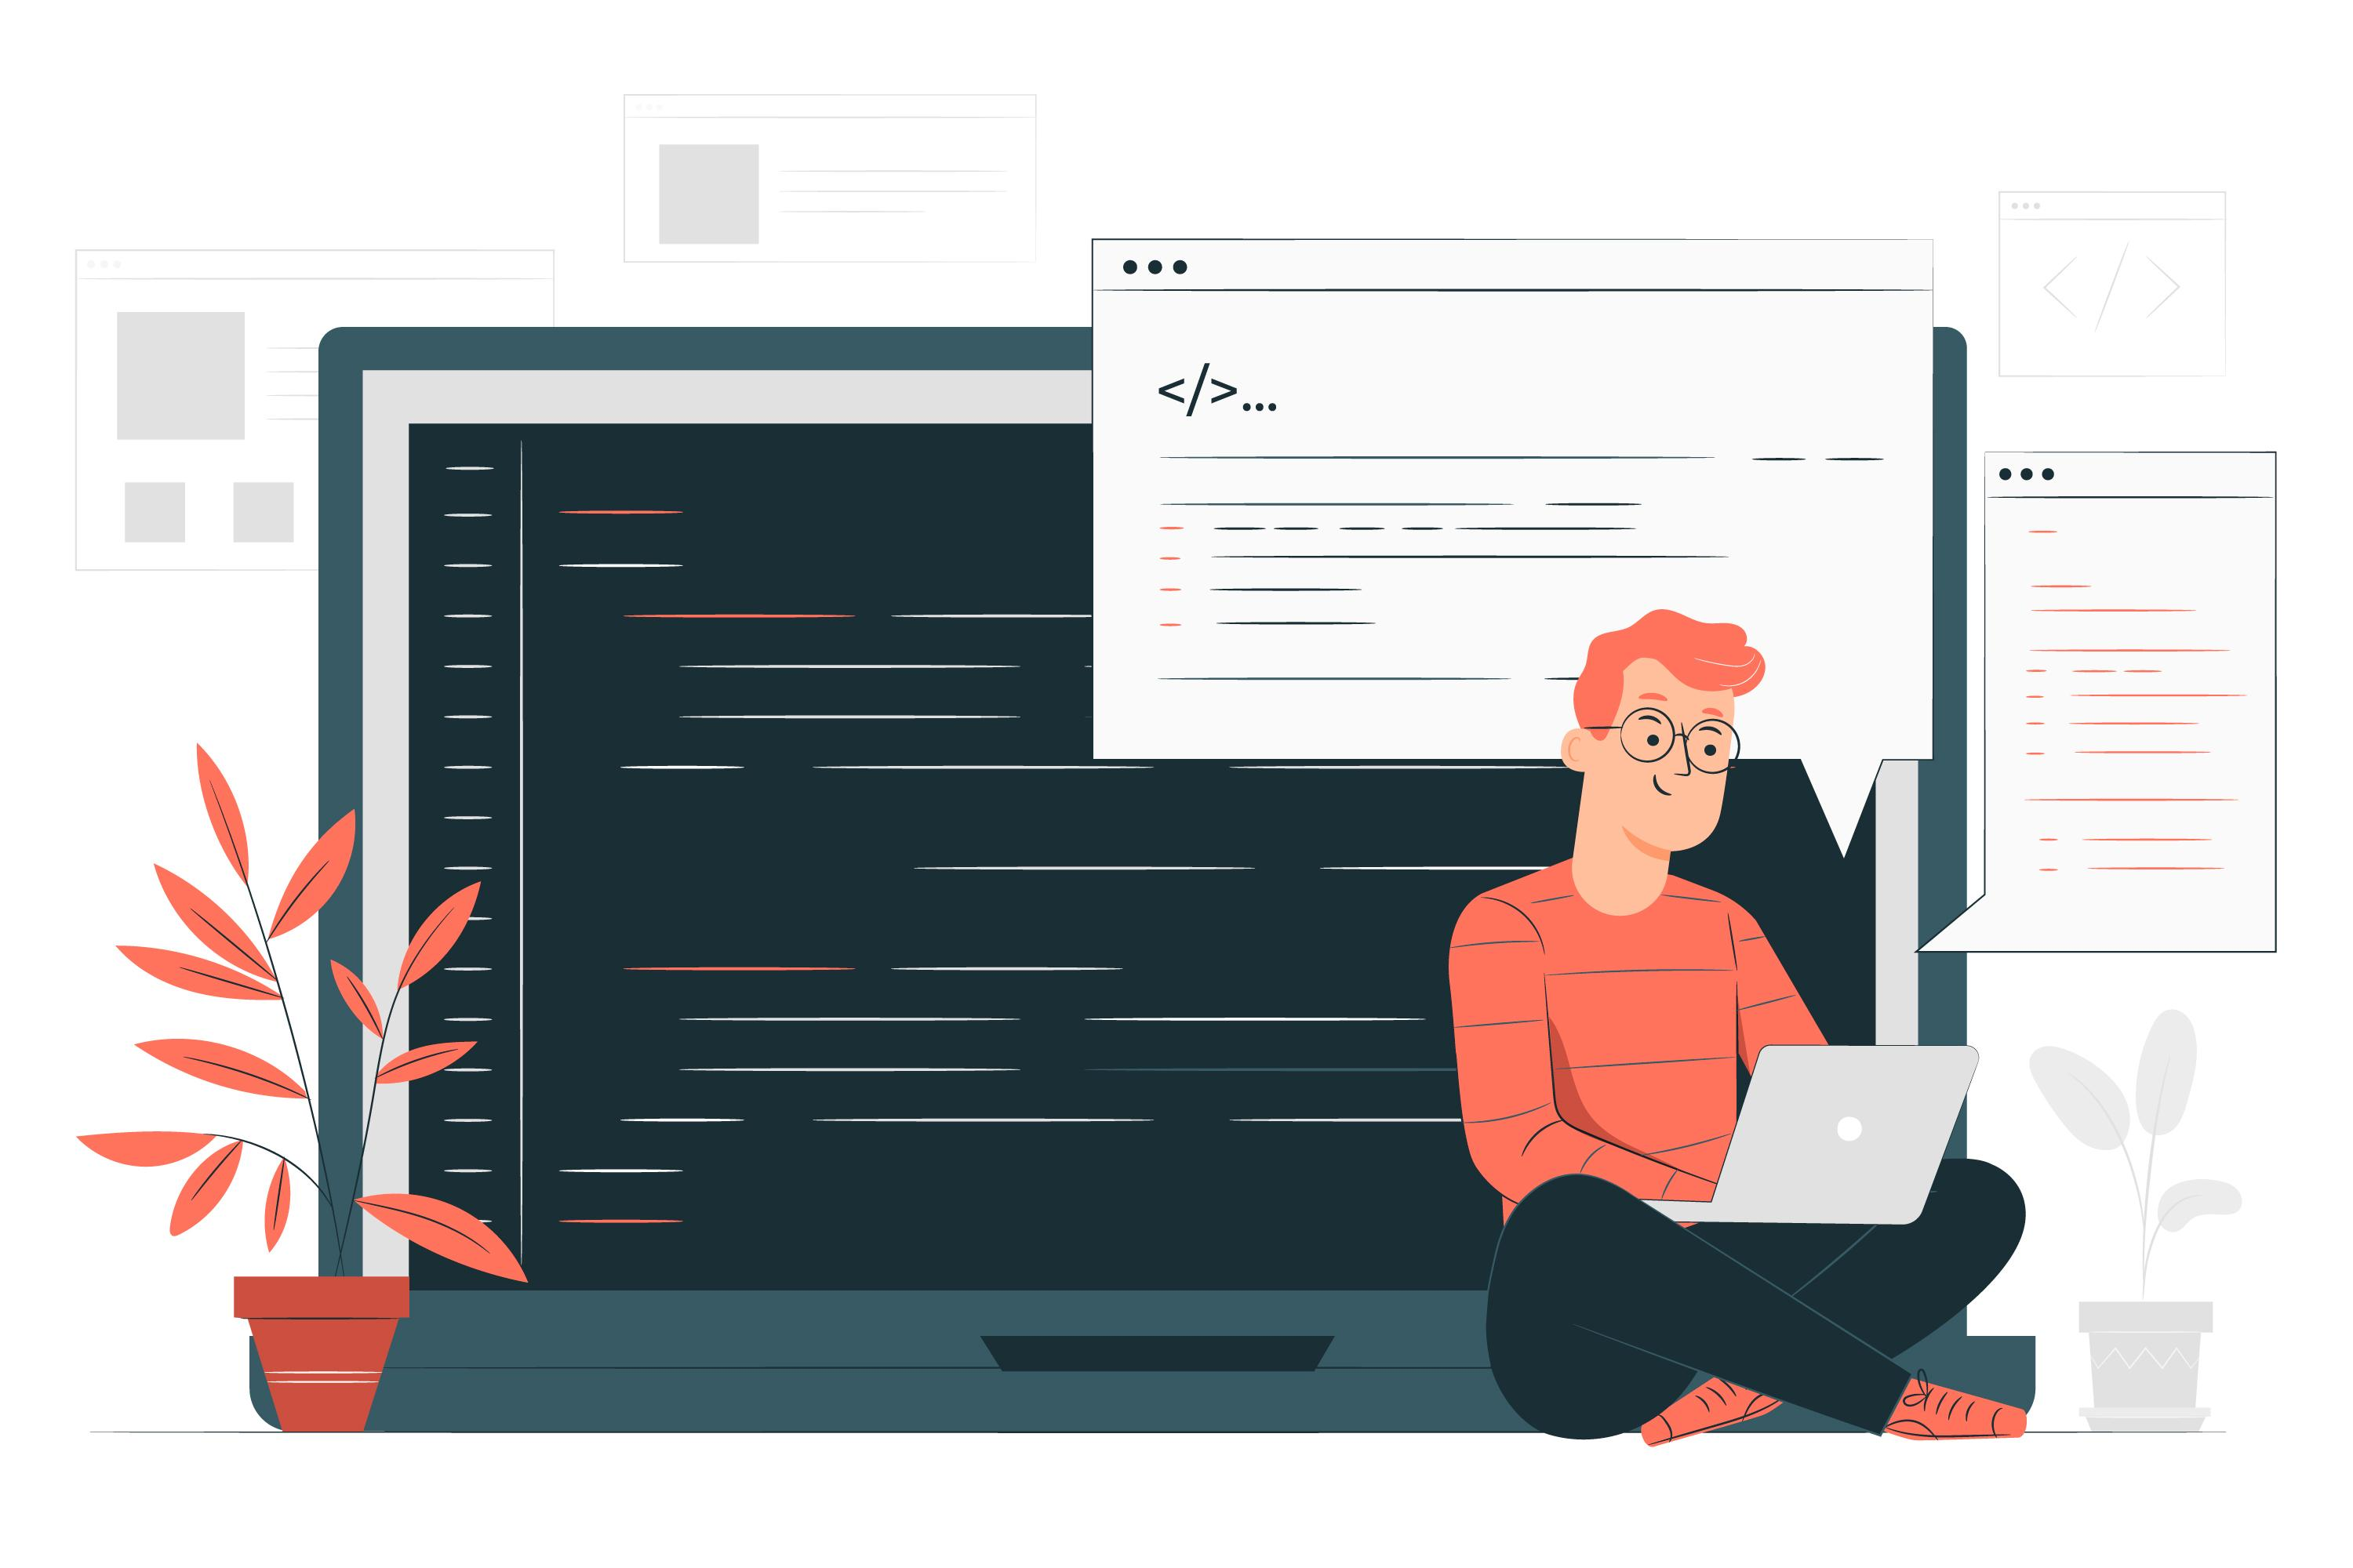
Resources and Technologies required for the project
Frontend : Flutter for interactive UI
Backend : Python or Node.js for API calls & data handling.
Database : PostgreSQL or MongoDB
Machine Learning Models : Decision Trees, Naïve Bayes Classifier or Neural network with scikit-learn.

Slide 5
Project Timeline and Key Milestones
Milestone | Duration | Key Milestone
Phase 1: Planning and Finalize requirements | Day 1 – 13 | Define system requirements, select data sources and finalize the technologies to use.
Phase 2: Questionnaire & Data Collection | Day 14 – 43 | Develop questionnaire, collect product data.
Phase 3: Recommendation Algorithm and Backend | Day 44 - 93 | Build recommendation engine, complete API backend.
Phase 4: Frontend Development and UI Design | Day 94 - 133 | Complete UI for questionnaire and recommendation display.
Phase 5: Testing & Optimization | Day 134 - 170 | Conduct testings and optimize performance.
Notes:
Consider features in the web app to add and research on how to handle the recommendations done to the users and not be liable about the recommendations. (Basically do research on the products and recommendation from the dermatologists view)

